Slide 1
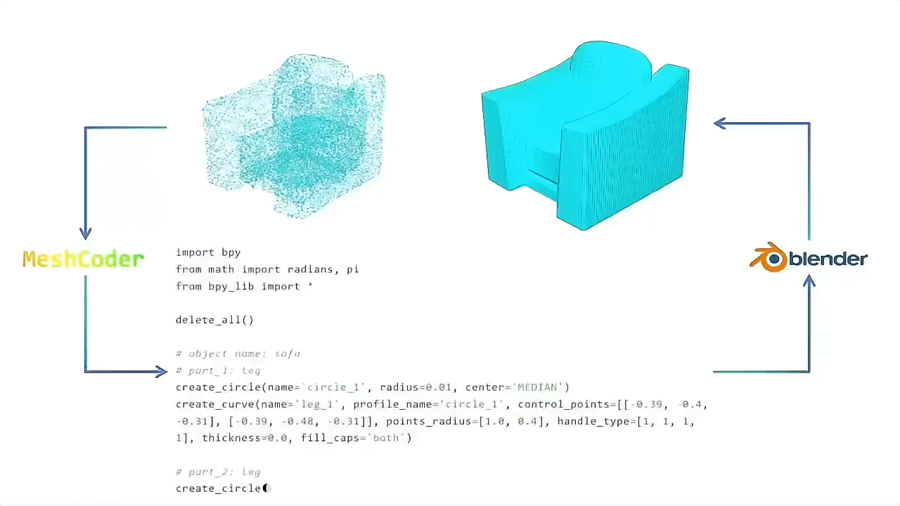
MeshCoder: LLM-Powered Structured Mesh Code Generation from Point Clouds
Bingquan Dai^{1,2*}, Li Ray Luo^{1, 3*}, Qihong Tang^{1,4,} Jie Wang^{1,5}, Xinyu Lian¹, Hao Xu^{1,6}, Minghan Qin², Xudong Xu¹, Bo Dai^{1,3}, Haoqian Wang^{2†}, Zhaoyang Lyu^{1†}, Jiangmiao Pang¹
¹Shanghai AI Lab ²Tsinghua University ³The University of Hong Kong
⁴Harbin Institute of Technology ⁵Beijing Institute of Technology ⁶HKUST(GZ)

Slide 2
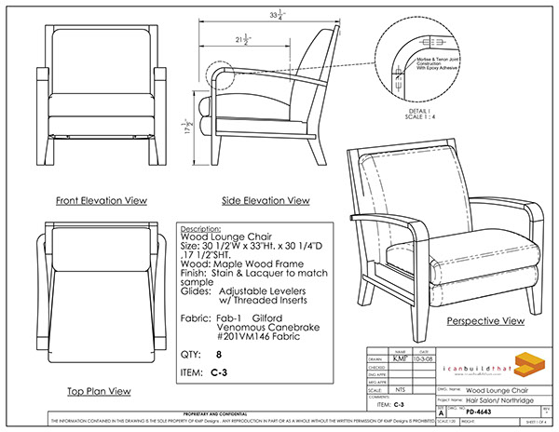
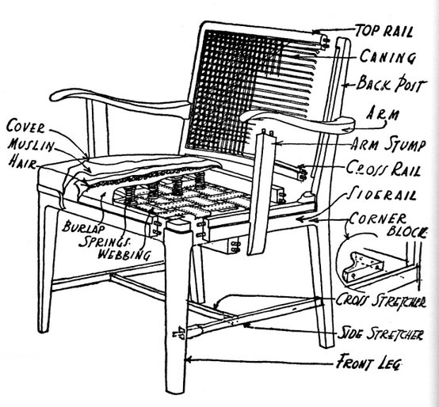
Motivating Problem
A nice sofa
The sofa with parametric details
How can we get parametric information from 3D shapes — and even make them editable?
reverse engineering

Slide 3
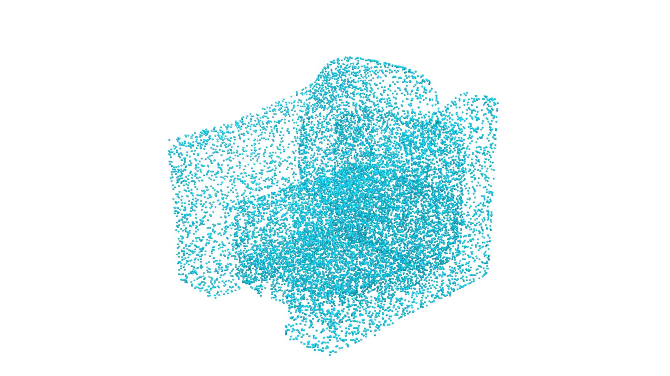
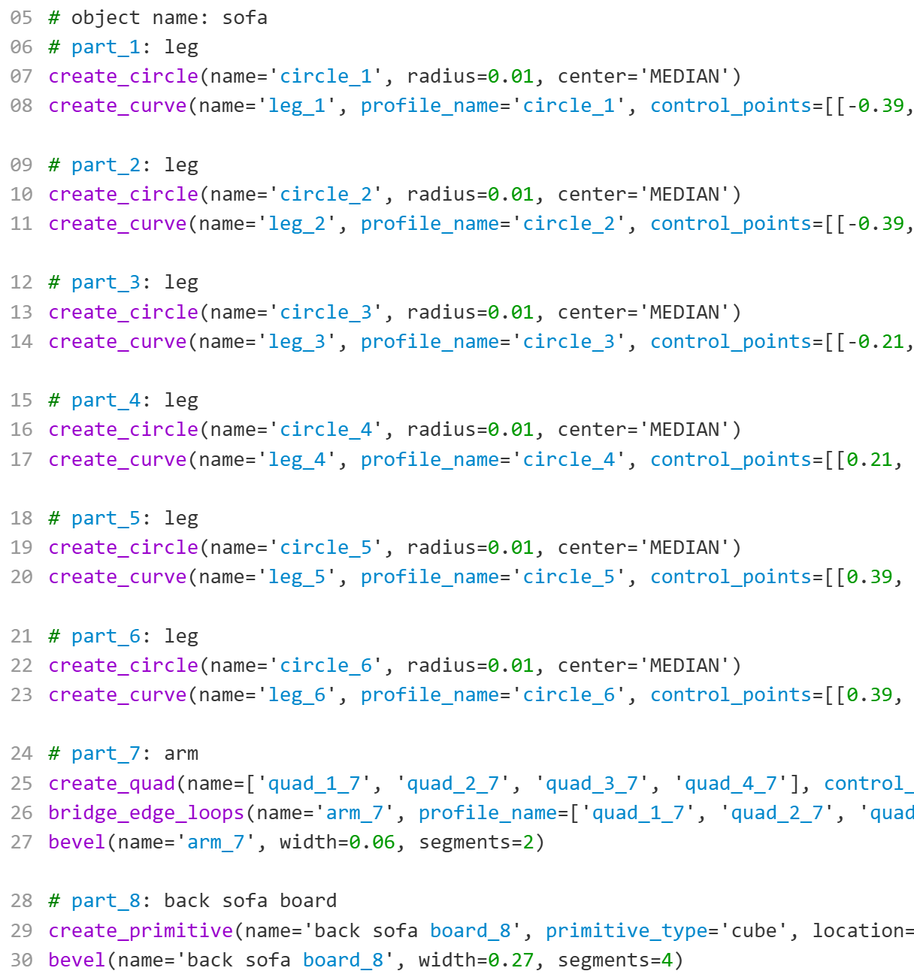
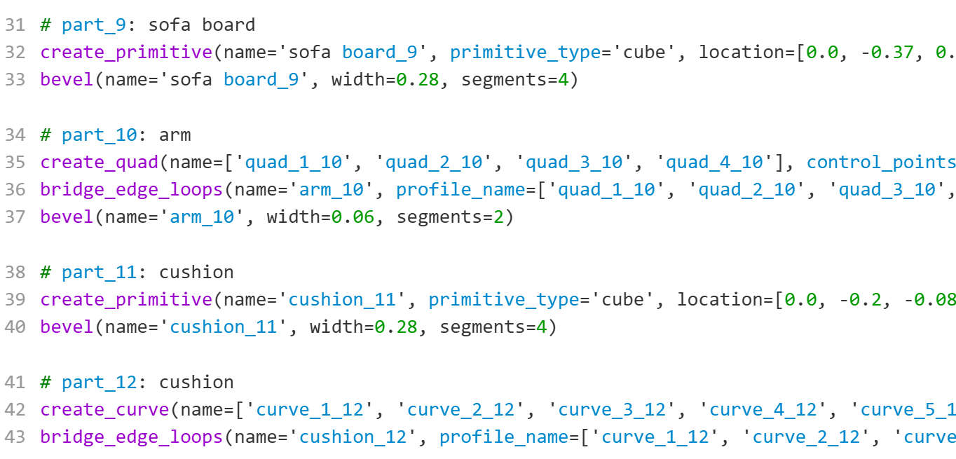
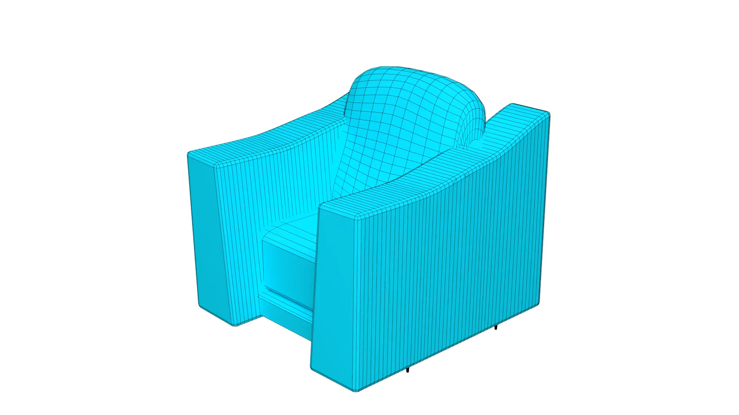
MeshCoder
Input:
Point
Cloud
⁝
Inference Model
Professional 3d software python codes
Output:
Structural
Mesh
Execute in Blender

Slide 4

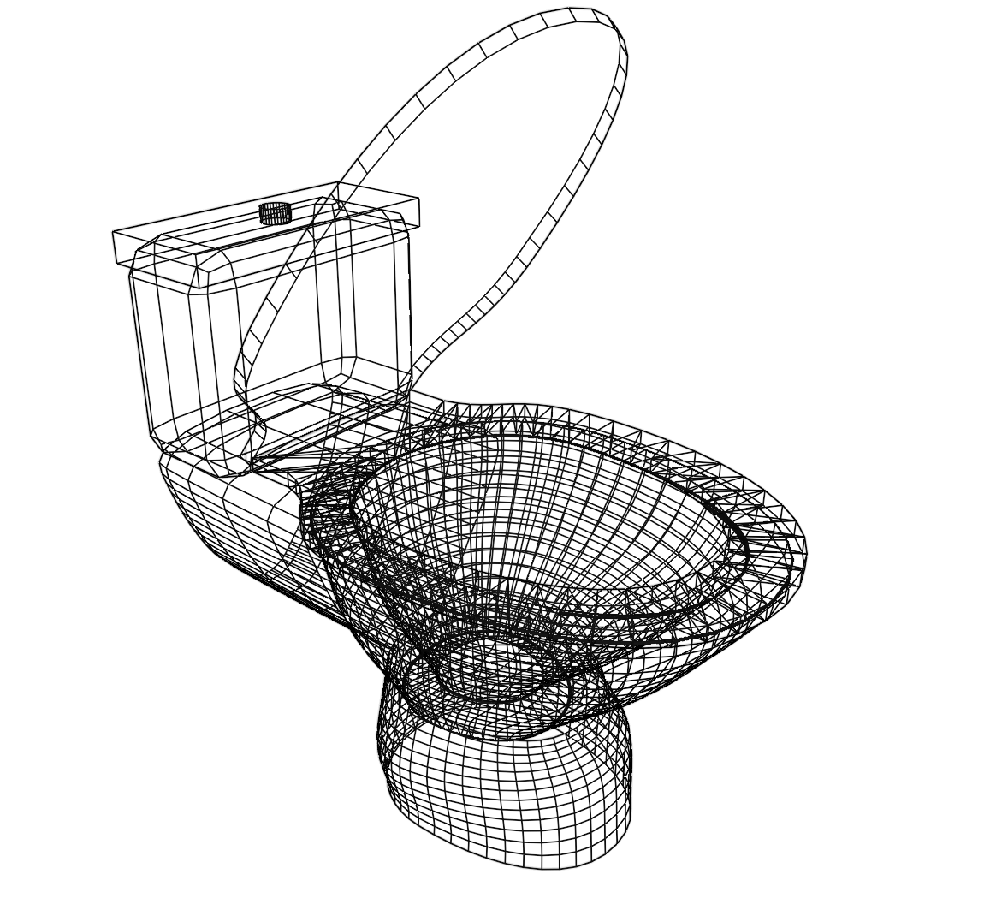
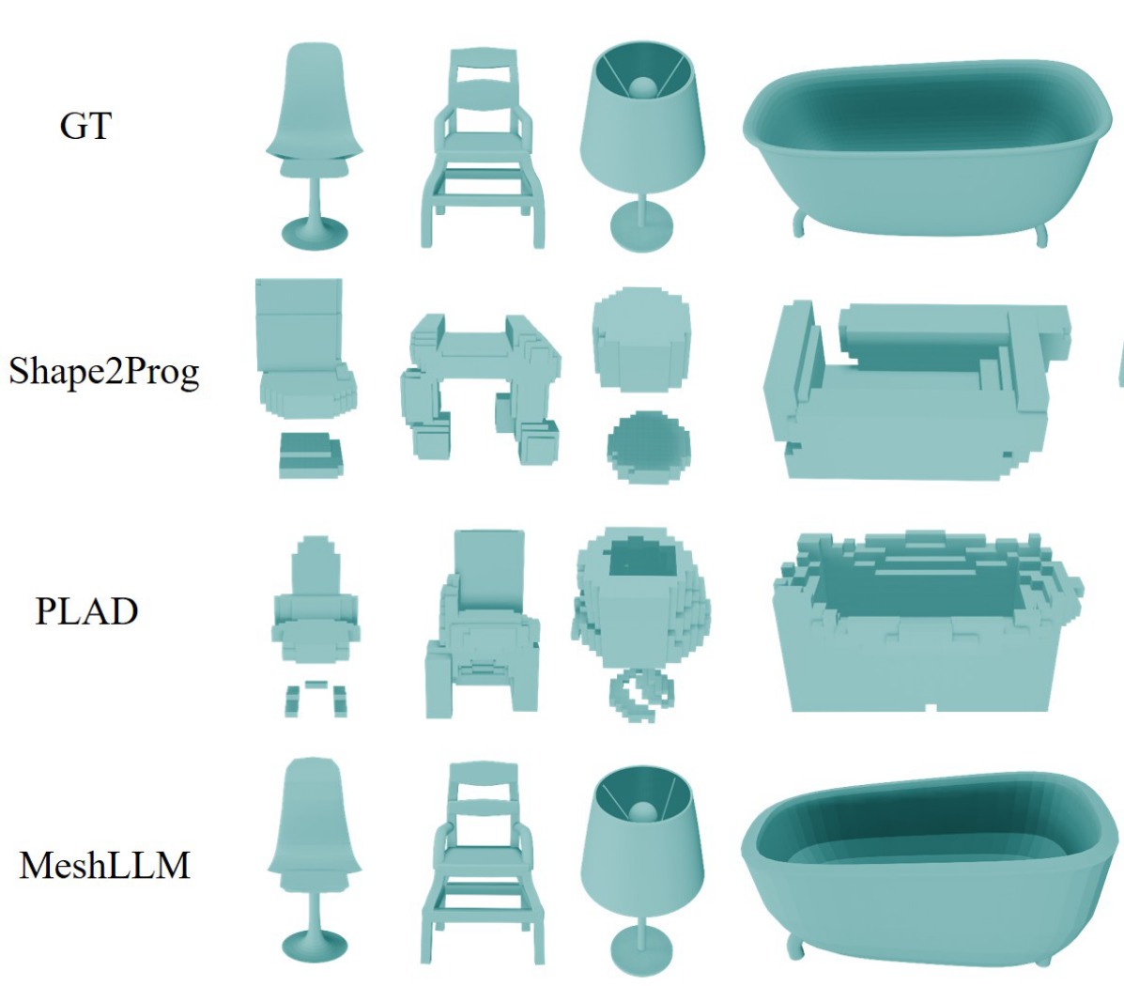
Our method achieves great performance
Diverse Categories
Clear Topology
Accurate Reconstruction
Ours

Slide 5
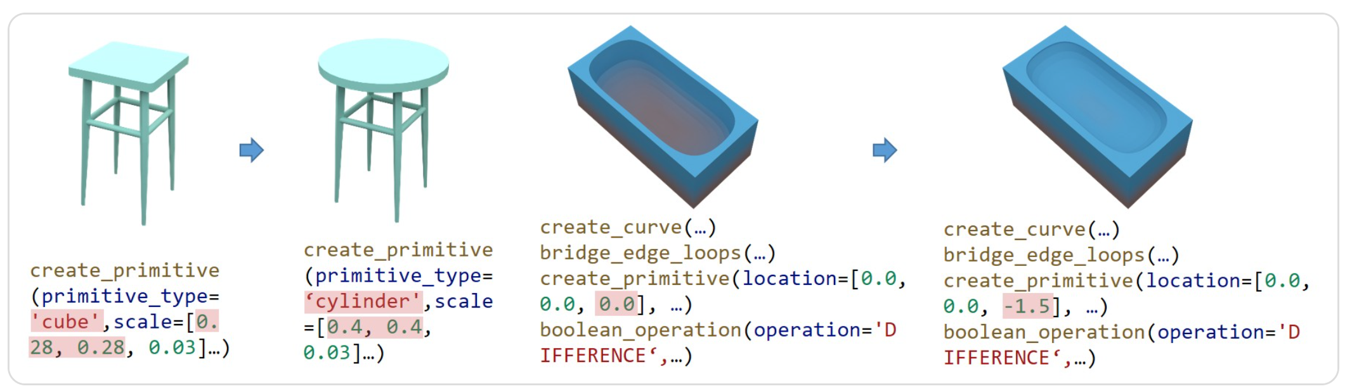
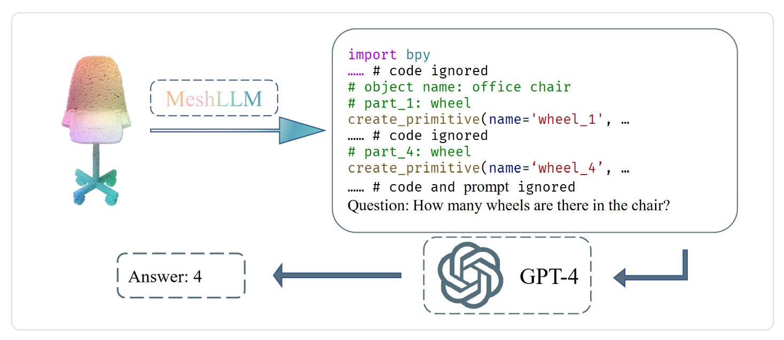
Unique features
Human editability
LLM understanding

Slide 6
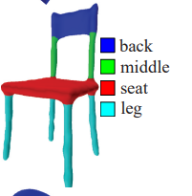
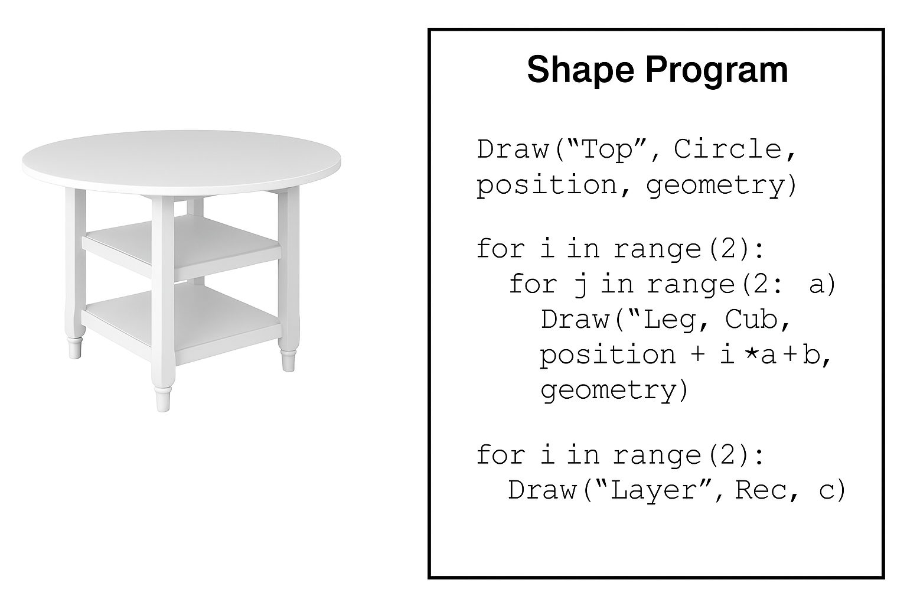
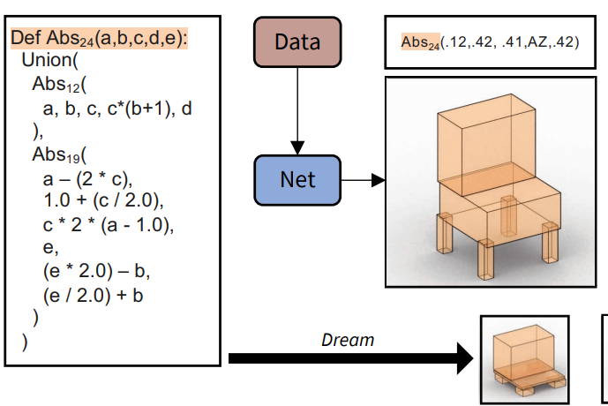
Existing Methods
3D Scanning + Mesh Segmentation
no parametric details & editability
(Kalogerakis et al, 2010) [1]
Shape Program-based
shape logic only, no industrial-level usage
(Tian et al, 2019) [2]
(Jones et al, 2023) [3]
[1] Kalogerakis et al. 2010. Learning 3D Mesh Segmentation and Labeling. ACM Transactions on Graphics (TOG).
[2] Tian et al. 2019. Learning to Infer and Execute 3D Shape Programs. International Conference on Learning Representations (ICLR).
[3] Jones et al. 2023. ShapeCoder: Discovering Abstractions for Visual Programs. ACM Transactions on Graphics (TOG)

Slide 7
Step 1
Structural Shape Expression

Slide 8

Build our own DSL
Based on Blender API
Operation name
Pseudocode
Primitive
primitive(‘cube', loc=…, rot=…, scale=…)

Slide 9


Build our own DSL
Based on Blender API
Operation name
Pseudocode
Primitive
primitive(‘cube', loc=…, rot=…, scale=…)
Sweep / Translation
sweep(profile='bezier', path='curve_spine', caps='both')

Slide 10



Build our own DSL
Based on Blender API
Operation name
Pseudocode
Primitive
primitive(‘cube', loc=…, rot=…, scale=…)
Sweep / Translation
sweep(profile='bezier', path='curve_spine', caps='both')
Boolean
boolean(A='cube', B='sphere', op='difference')

Slide 11

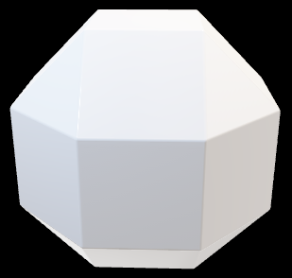

Build our own DSL
Based on Blender API
Operation name
Pseudocode
Primitive
primitive(‘cube', loc=…, rot=…, scale=…)
Sweep / Translation
sweep(profile='bezier', path='curve_spine', caps='both')
Boolean
boolean(A='cube', B='sphere', op='difference')
Loft / Bridge Loop
bridge_loops([c1,c2,c3,c4], smooth=0.6)

Slide 12
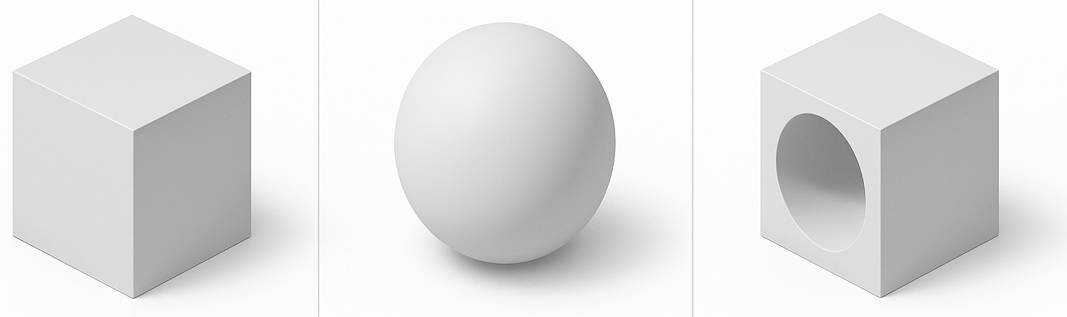
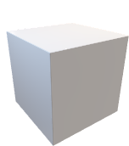
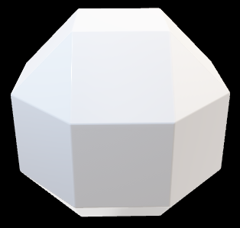
Build our own DSL
Based on Blender API
Operation name
Pseudocode
Primitive
primitive(‘cube', loc=…, rot=…, scale=…)
Sweep / Translation
sweep(profile='bezier', path='curve_spine', caps='both')
Boolean
boolean(A='cube', B='sphere', op='difference')
Loft / Bridge Loop
bridge_loops([c1,c2,c3,c4], smooth=0.6)
Array
array('cube', type='grid', counts=(4,4), step=(0.2,0.2))
…

Slide 13
Build our own DSL
Based on Blender API
Operation name
Pseudocode
Primitive
primitive(‘cube', loc=…, rot=…, scale=…)
Sweep / Translation
sweep(profile='bezier', path='curve_spine', caps='both')
Five types of code blocks to express almost every 3d object.
Boolean
boolean(A='cube', B='sphere', op='difference')
Loft / Bridge Loop
bridge_loops([c1,c2,c3,c4], smooth=0.6)
Array
array('cube', type='grid', counts=(4,4), step=(0.2,0.2))

Slide 14
Dataset Construction
Step 2

Slide 15
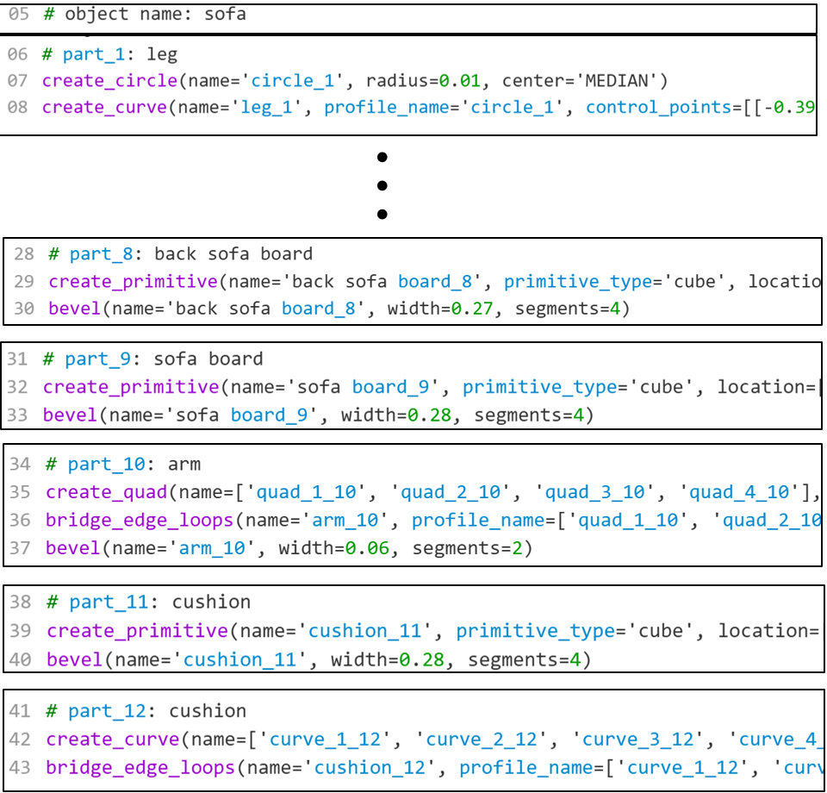
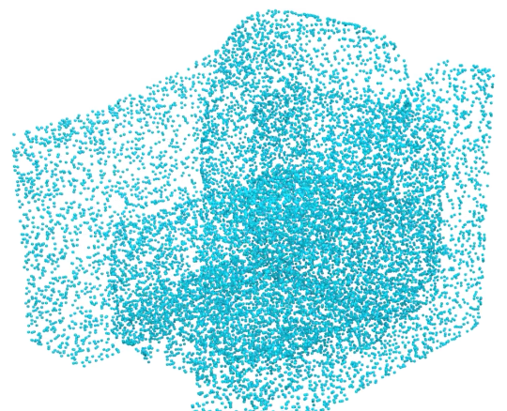
Basic Idea
Aim: Construct an (object point cloud, code) dataset for the inference model to learn from.
(
)
,
Structural, part by
part
Step 2: Train a part-level inference model

Slide 16
Basic Idea
part level dataset
part level inference model
object level datasets
Step 2: Train a part-level inference model

Slide 17
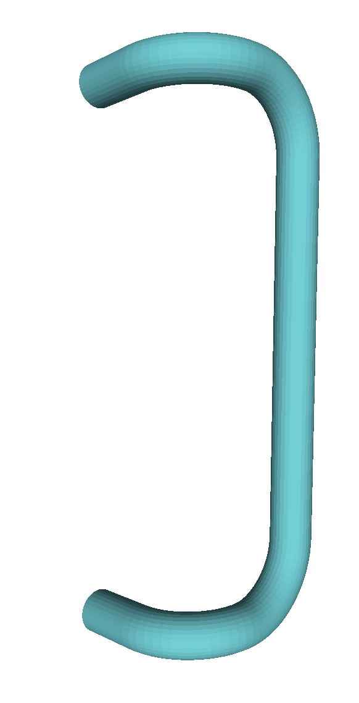
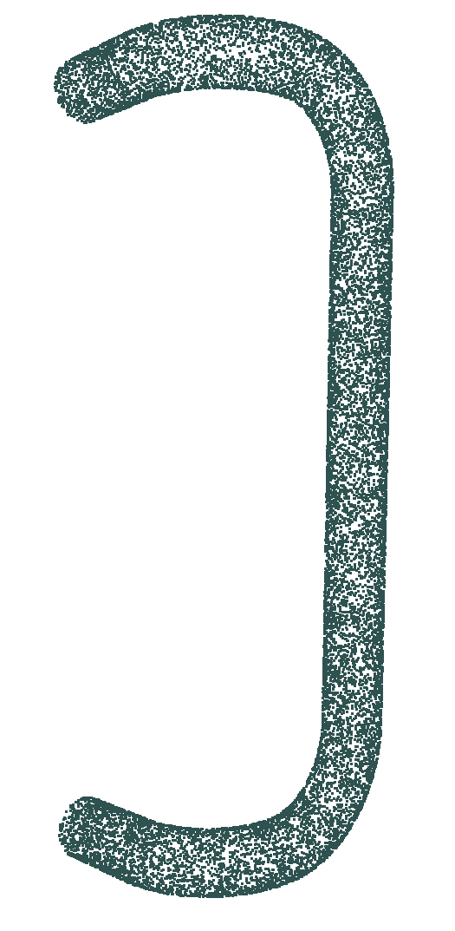
Basic Idea
Part-level
Part-level python codes
Code generation Programs
GPT draft + Human refine

Slide 18
Basic Idea
Part-level
Part-level python codes
Code generation Programs
GPT draft + Human refine
(
)
,
(Point Cloud, Code) data pair

Slide 19
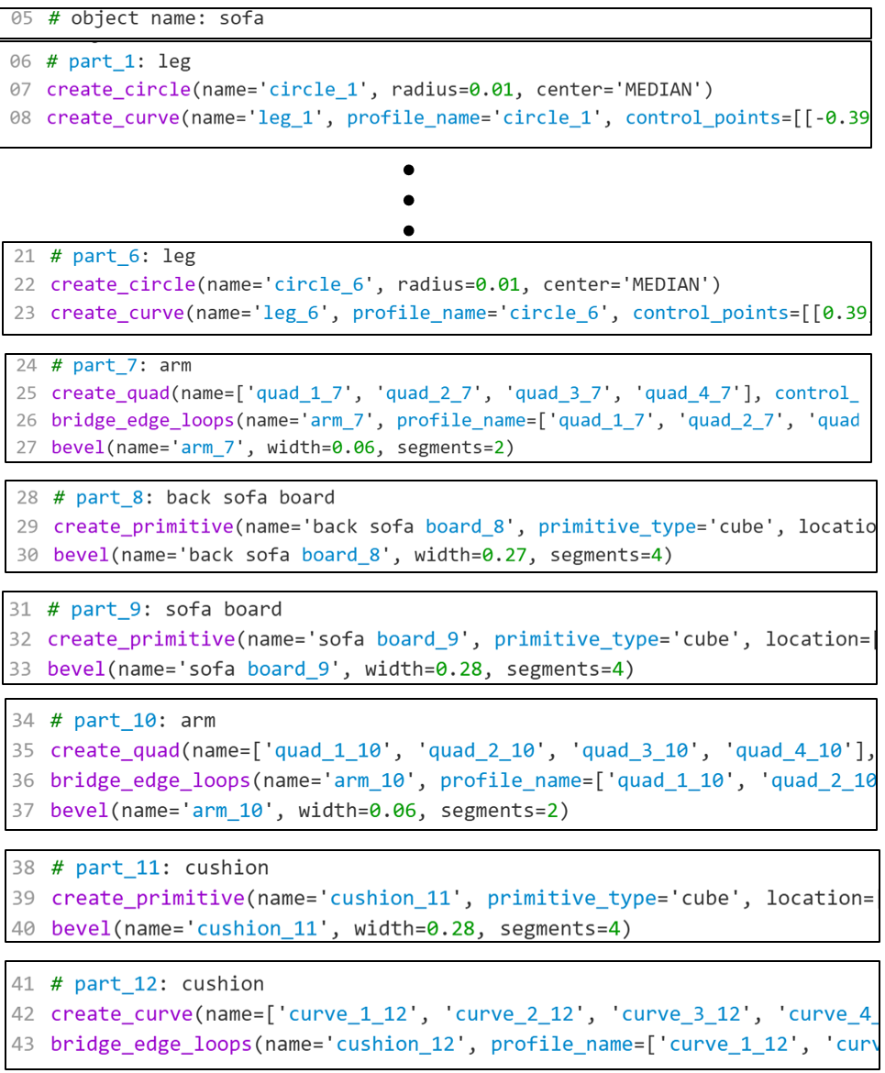
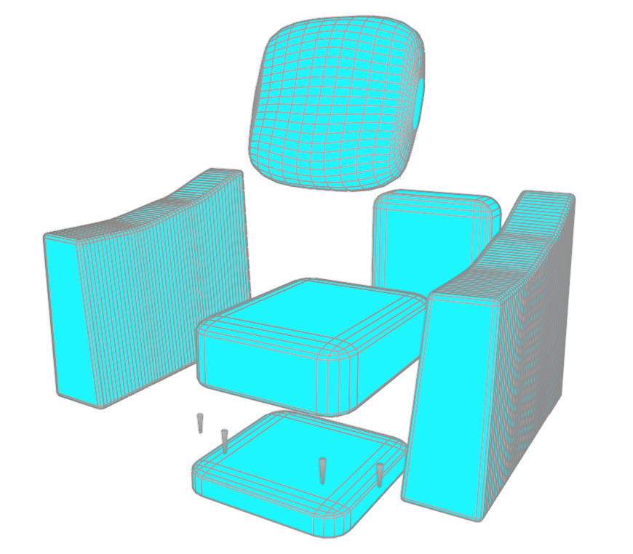
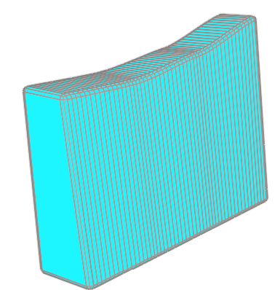
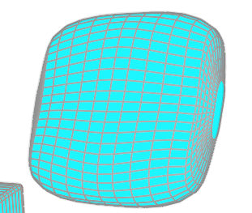
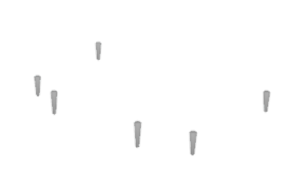
Basic Idea
Object-level
Extract Point Cloud
Part-level Inference model
……
……

Slide 20
Inference Model Overview
Step 3

Slide 21
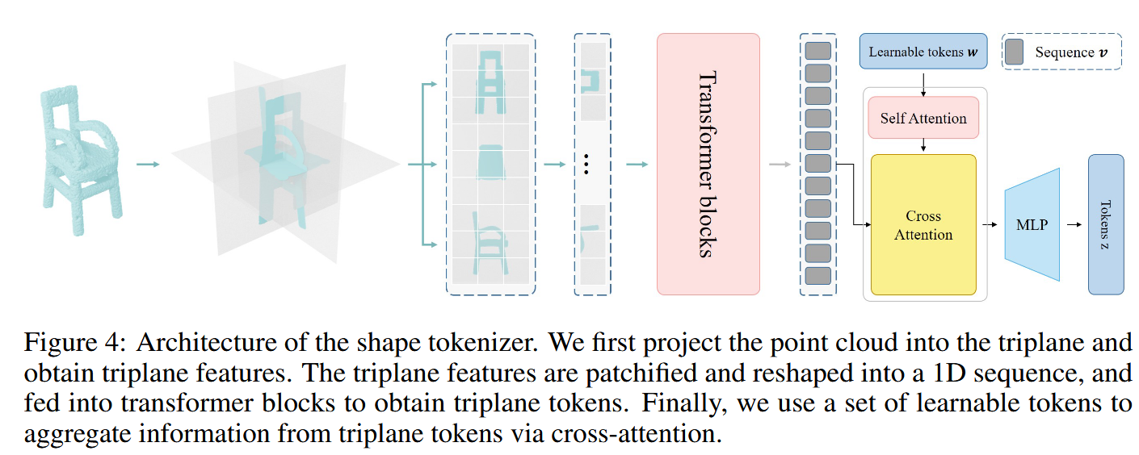
Model
shape tokenizer
code generation model

Slide 22
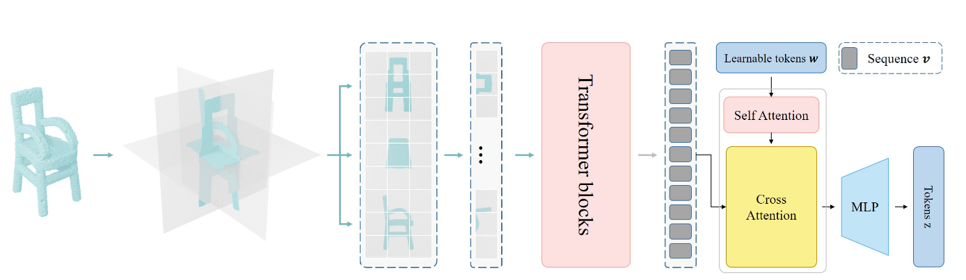
Model
shape tokenizer
Patchify and flatten
Learnable tokens with cross-attention
Projection to triplanes
Transformer blocks

Slide 23
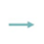
Model
code generation model
Finetuned LLM
Llama-3.2-1B with LoRA finetuning

Slide 24
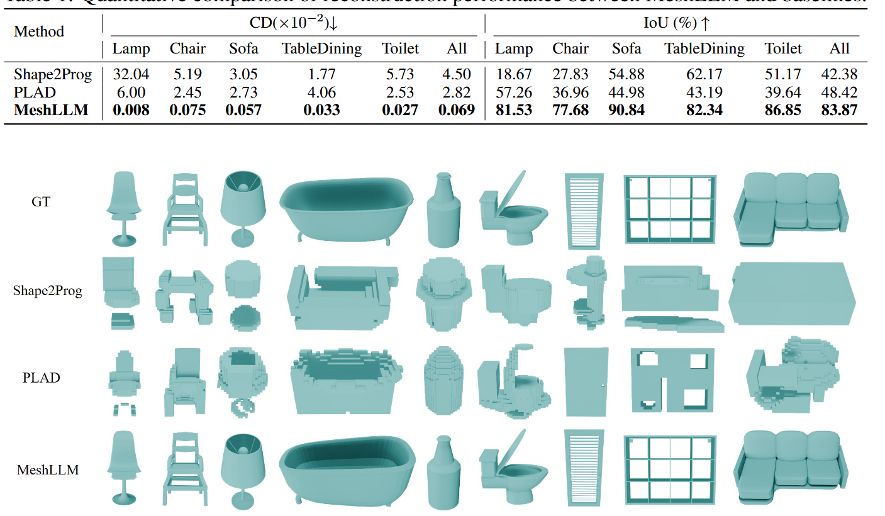
Experiment
Ours
(Tian et al, 2019) [1]
(Jones et al, 2023) [2]
Ours
[1] Tian et al. 2019. Learning to Infer and Execute 3D Shape Programs. International Conference on Learning Representations.
[2] Jones et al. 2023. PLAD: Learning to Infer Shape Programs with Pseudo-Labels and Approximate Distributions

Slide 25
Contributions
Expressive Blender API Library
Embedded DSL for procedural modeling (primitives, patterns, sweeps, lofts).
Large-Scale Dataset Pipeline
Synthesized 10M+ part & 1M object point cloud–code pairs.
Shape-to-Code Inference Model
Encoder (shape tokenizer) + decoder (finetuned LLM) → executable code, enabling reconstruction, editing, and reasoning.

Slide 26
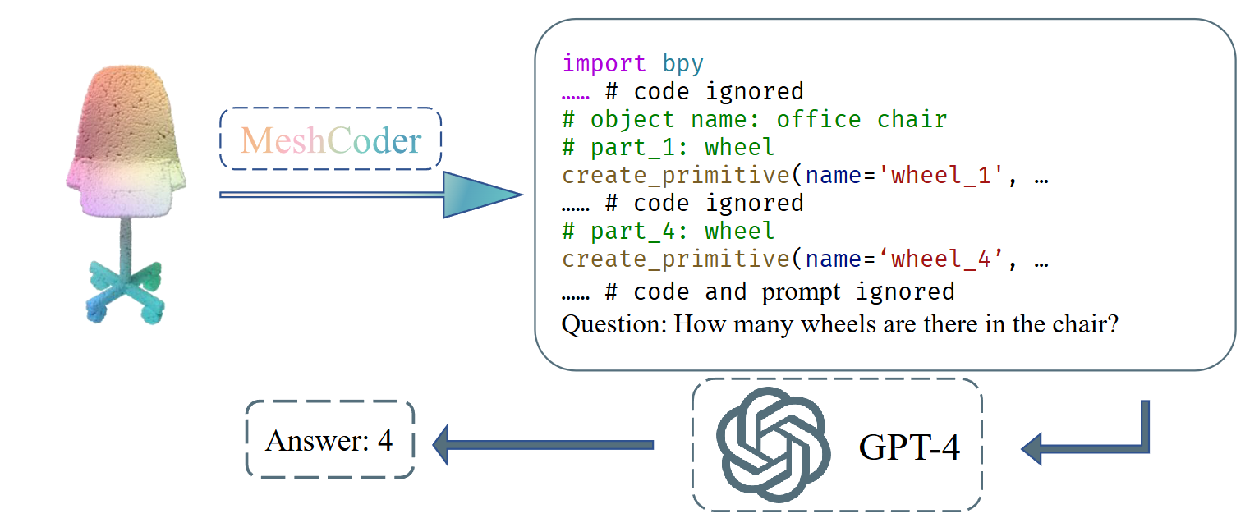
Code-Based Editing
Contributions
A new representation paradigm: one that makes 3D shapes editable, interpretable, and semantically meaningful — all thanks to code.”
Semantic Reasoning

Slide 27
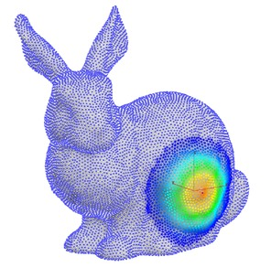
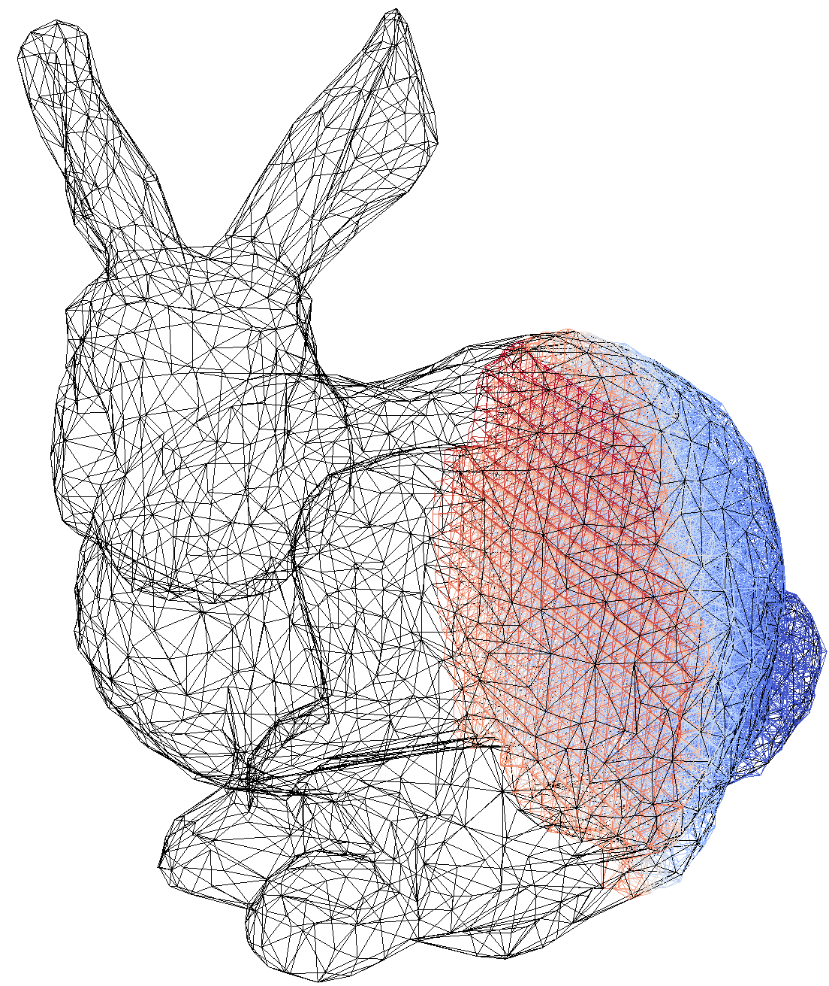
Challenge
废稿
: Structural Symbolic Shape Expression
Point Cloud
Simple Shape Program
Mesh
[Tian, Y. 2019] (1)
Low Level Patterns
shape logic only, no industrial-level usage
(1): Tian, Y: Learning to infer and execute 3d shape programs. 2019

Slide 28
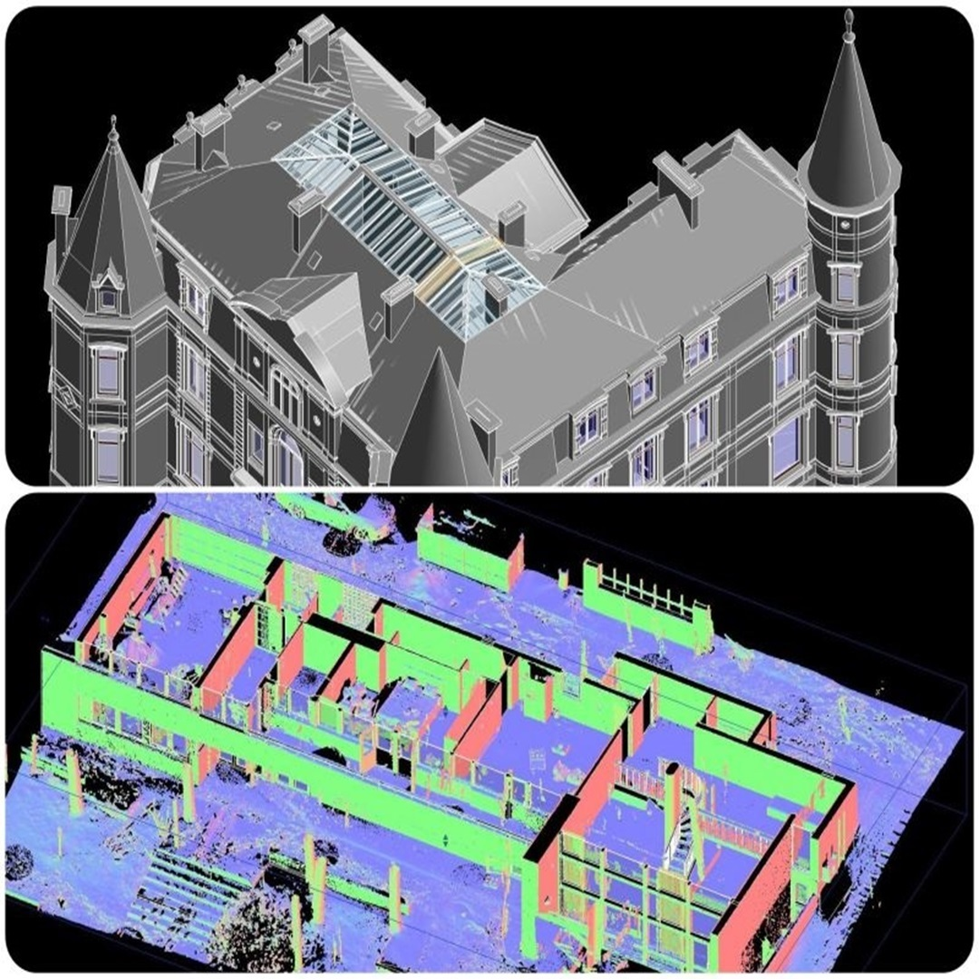

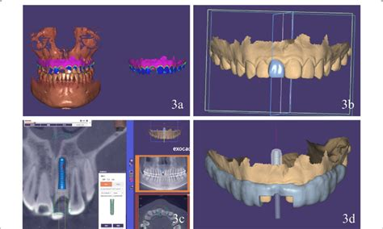
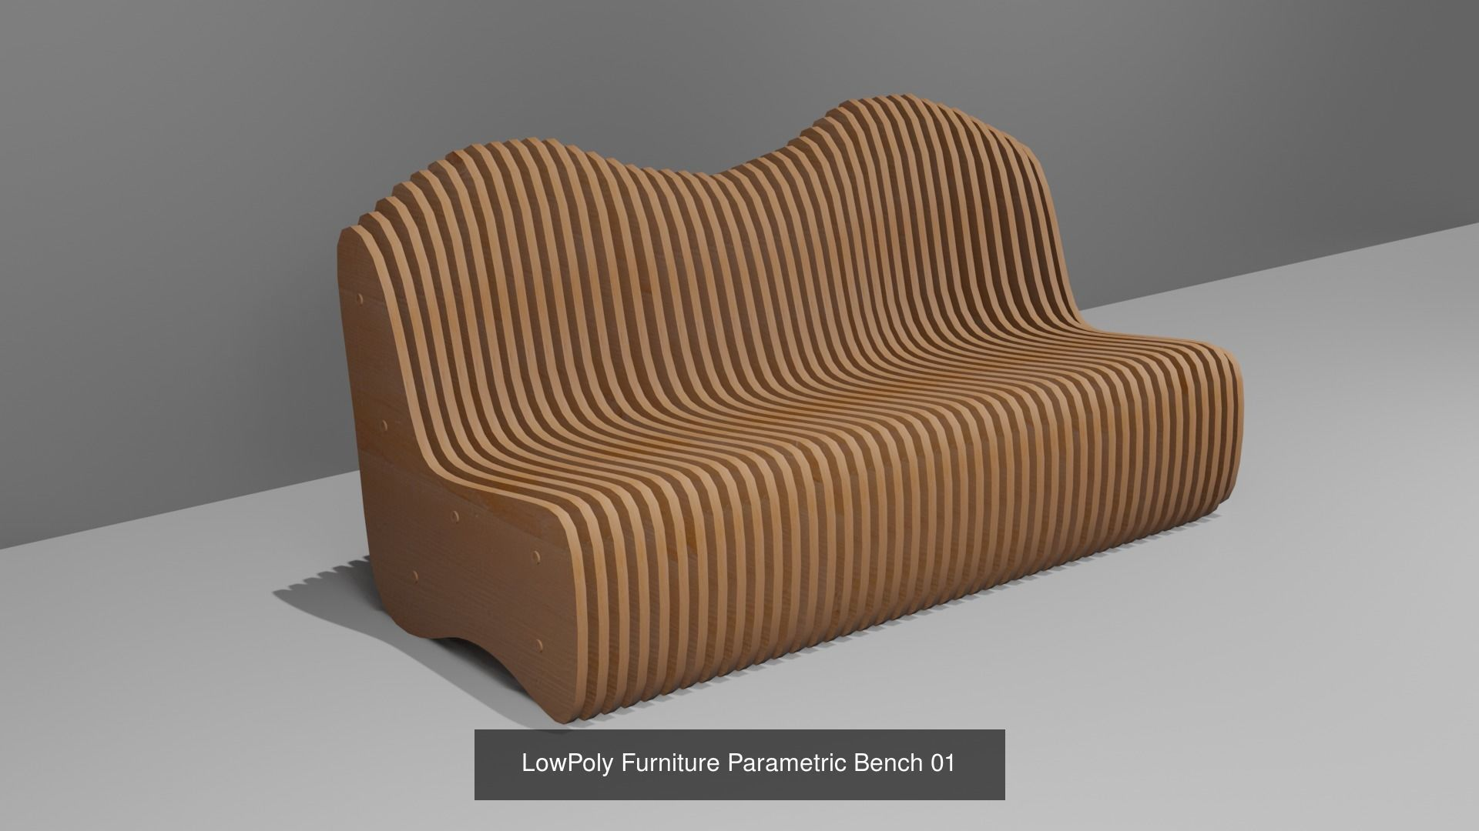
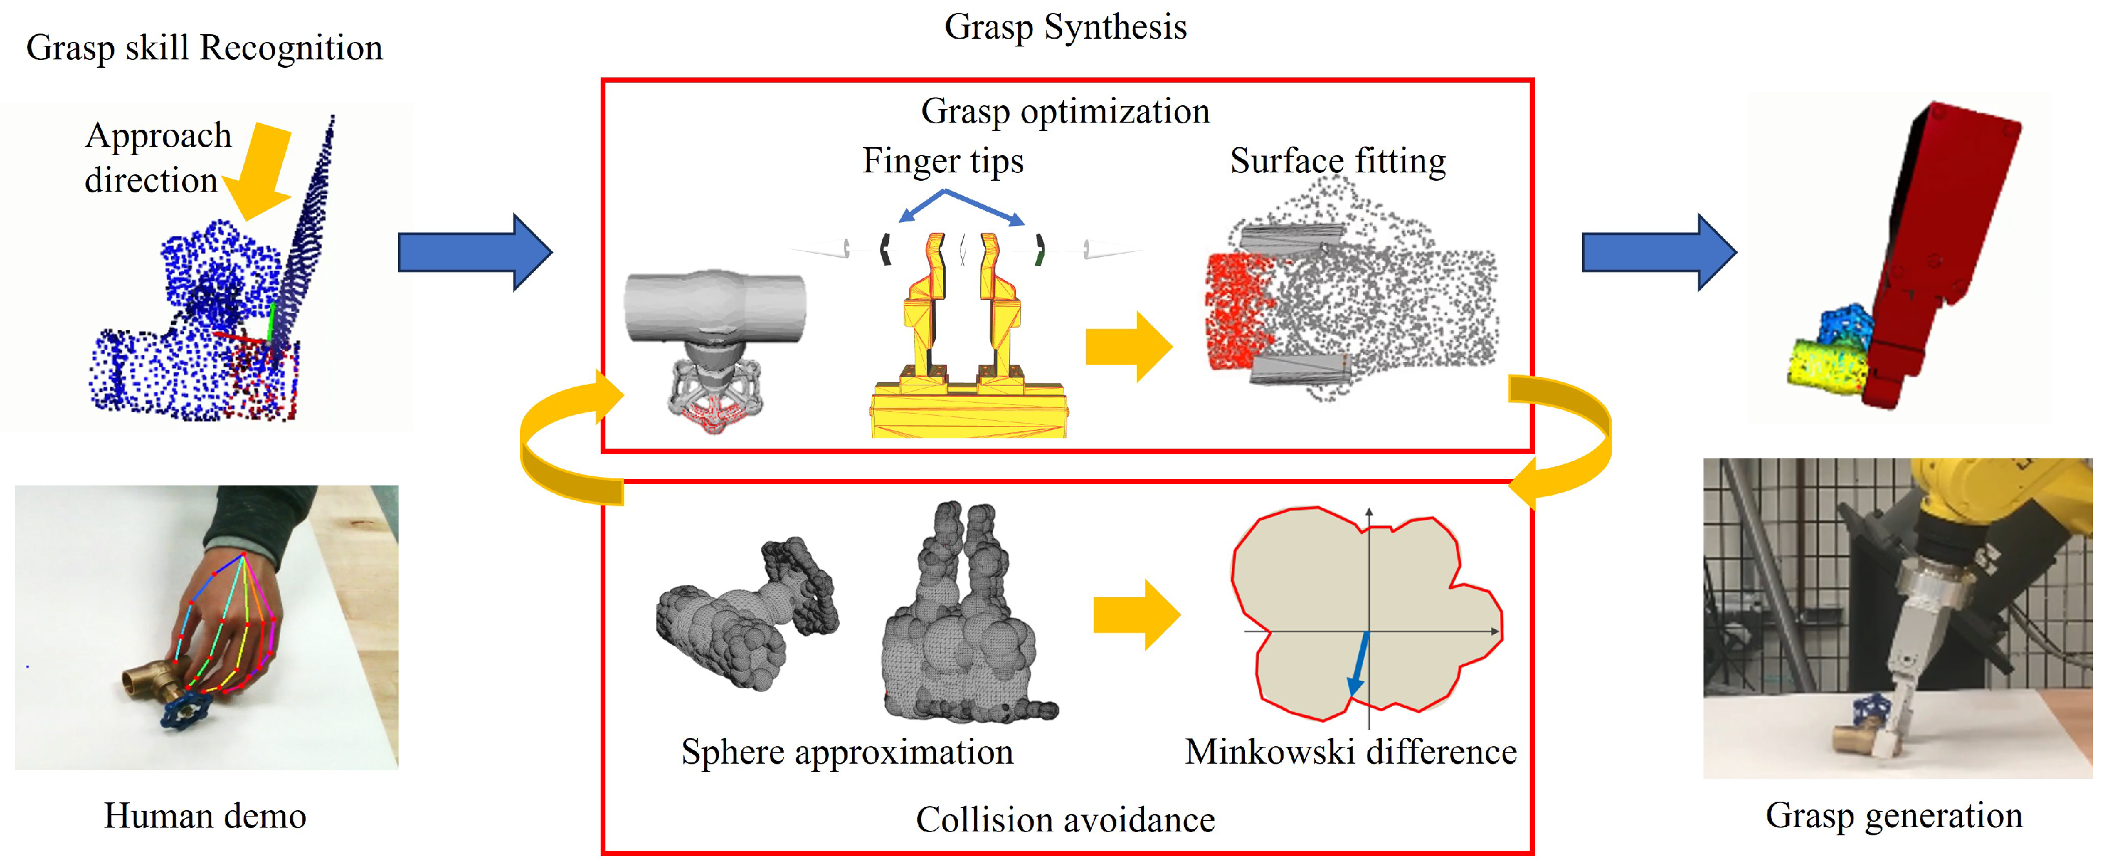
Cultural Heritage
Generating & Reconstructing complex 3D shapes is important in many fields
Architecture Analysis
Medical Implants
Furniture Design
Robotics & Simulation

Slide 29
Conclusion & Future work
So to sum up: MeshCoder combines a large part-based dataset, a Blender API, and a multimodal LLM to reconstruct and understand 3D shapes as code.” “It supports editing, reasoning, and better generalization than former basic DSL-based systems.” “We’re excited to extend this to organic shapes and explore interactive editing in the future.”

